Slide 1
Introduction to CSS

Slide 2
Why CSS?
CSS Provides Efficiency in Design and Updates
CSS relatively easy to use
Can give you more flexibility and control
Faster loading pages
Increased consistency
Brings more sophistication to web design
CSS is designed primarily to enable the separation of document content from document presentation.

Slide 3
Why CSS? (continued)
W3C standard, started in 1996
Improves accessibility
Tables not required for elegance
Reduces the complexity of pages
Which in turn has led to more sophistication…
It’s opened up the way for other technologies to be built on and supported by CSS. There are dozens, and still growing.
Example, “Bootstrap”, which is an open-source framework that combines CSS, HTML, and JavaScript.

Slide 4
CSS Overview
CSS (Cascading Style Sheets)
CSS defines HTML display
Styles were added to HTML 4.0 to solve a problem
External Style Sheets are stored in .css files

Slide 5
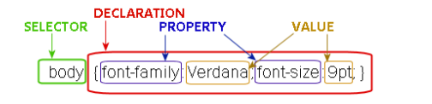
CSS Syntax
Selectors
Declaration
Properties
Values

Slide 6
Selectors
A “selector” is an instruction in a CSS rule set that tells the browser what elements to ‘select’ for styling.
Here are some that we will look at:
element Selector
id Selector
class Selector
grouping Selectors

Slide 7
Element or Tag Selector
This selector selects tags by tag or “element” name.
This selector must match one or more HTML elements of the same name.
Easiest to use.

Slide 8

Element Selector
p { text-align: center; color: red; }
HTML
<p>UAlbany is one of the SUNY centers.</p>

Slide 9
ID Selector
The ID selector is a unique identifier to an element.
The id selector is used if you want to select a single, unique element.
CSS uses a hash or pound sign (#) to indicate its ID
ID’s are unique
ID’s, in theory, are only supposed to be used once per page
In other words, a page would not be validated by W3C standards.
Anytime we see ID in the computer world, think “unique”.

Slide 10

The id Selector
#text1 {
text-align: center;
color: green;
}
<h1 id="text1">Think Spring!</h1>

Slide 11
Class Selector
This selector allows you to style content irrespective of what tag you apply it to
Classes are NOT unique
Use the same class on multiple elements.
Use multiple classes on the same element.

Slide 12

The class Selector
.center {
text-align: center;
color: green;
}
<h1 class="center">Think Spring!</h1>
<p class="center">Think Spring!</p>

Slide 13
CSS Grouping
When several selectors share the same declarations, they may be grouped into a comma-separated list.
Take this
h1 { font-family: sans-serif }
h2 { font-family: sans-serif }
h3 { font-family: sans-serif }
And, do this:
h1, h2, h3 { font-family: sans-serif }

Slide 14
CSS Comments
As with other computer languages, CSS allows for comments
Comments remind you and tell fellow coders what your CSS does
Allows you to “flag” code for further review
Indispensable for large website and programming projects

Slide 15
CSS Comments
h1 { font-size: 24px; font-weight: bold; border: 1px solid black; color: pink; }
/* This will make all <h1> headers big, bold, pink, and inside of a thin black rectangle! */

Slide 16
Ways to Insert CSS
Externally
Internally
Inline styles (inside tags)

Slide 17
Inline Styles
Insert CSS style right within the HTML tag that you want to apply them too.
Very quick
However, difficult to maintain
Use sparingly
<h1 style="color:blue;margin-left:30px;">Think Spring!</h1>

Slide 18
Internal (or Embedded) CSS
Placed right on top of the page that it will affect
As with DTDs, you can internally create a stylesheet
They are more convenient for small webpages
Mixing content and style will cause your pages to become unwieldy over time.

Slide 19
Internal CSS stylesheet
<html> <head> <style type="text/css"> p {color: white; } body {background-color: black; }
</style> </head> <body> <p>White text on a black background!</p> </body> </html>

Slide 20
External Stylesheet
Why use an external stylesheet?
It keeps your website design and content separate.
CSS code is easier to reuse.
Instead of typing the same CSS code on every web page you have,
Merely have many pages refer to a single CSS file with the "link" tag.
You can make massive alterations to your web pages with just a few changes in a single CSS file

Slide 21
External CSS Stylesheet
In yours.XSL file, you will link out using this command:
<head> <link rel="stylesheet" type="text/css" href="mystyle.css“/> </head>

Slide 22
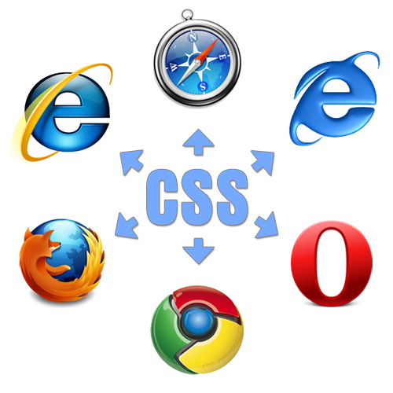
Browsers and CSS3
To be replaced by the project “Spartan”

